Slide 1
Women’s Security App
- By Team United:
Praneet Botke (RA1911031010149)
Sai Mohit Ambekar (RA1911031010137)

Slide 2
Glimpse
Women’s security is a critical issue in today’s world and it’s very much needed for every individual to be acting over such an issue.This Ppt describes a “Women Security System” that provide alerts and messages with an emergency button trigger whenever somebody is in trouble. Nowadays due to recently happened cases such as molestation by drivers or colleagues, burglary etc., women security, especially women security has become the foremost priority of the world.

Slide 3
Problem Statement
The main purpose the project is to provide highly reliable security system for the safety of women.The basic aim of the system is to develop Women's Safety App. The main objective of the system is to track the current location of the person or either inform the police about the distress.

Slide 4
Idea
We provide this application were women and other user can use this application to contact the parents and friends in the time of need or in case of any emergency .The application provide a friendly interface to use various other emergency tools at the time of emergency. The application can be used both in online and offline mode.
The user just needs to tap certain times on the Power button to use the tools such as loud alarm button ,texting along with sending the user location and sending the location via the SMS when the end user is not having the App.

Slide 5
Drawbacks: What’s the need when there are already such Apps flowing ?
Requires good network connectivity.
Good Android platform.
Difficult to inform immediately the location of the user in trouble.
Requires the use of initiating the App manually.

Slide 6
Uniqueness of our App
Whenever the user shakes his/her phone, a distress signal will get generated automatically and then a message alert is sent to the contacts which are added in the emergency contacts list.
User-friendly interface
Immediate responding and alerting.
No need for manually initiating the App.
Automatically dialing to the nearest Police Station in case of Offline.

Slide 7
Challenge Accepted !
Online
When the user has good Network Connectivity - Shaking the mobile / tapping the Power Button sends the Distress Signal to Emergency Contact List & nearest Police Station about the Distress along with location.
Offline
It isn’t always the user could get proper Network Connectivity. For this purpose the App is designed to go for the Else of Online i.e. Shaking the mobile / tapping the Power Button will Dial to the nearest Police Station of the Distress.

Slide 8
Technical Feasibility
Operational Feasibility
Economic Feasibility
Technical feasibility is the most difficult area to ensure at initial stage. Since the objectives, functions, performance cannot be predicted to its fullest, everything seems possible, provided the right assumptions are made.
It deals with the consideration about working of the system after installation. The proposed system would be beneficial to its users as their needs are fully satisfied. As this project satisfies all the requirements of the users it is operationally feasible. All the operational aspects are considered carefully here. It should be able to: Process large amount of Data.
Fast and accurate information.
Resource cost is based on the estimated resources within the technical analysis.
Resource cost is based on the estimated resources within the technical analysis
Resource cost is based on the estimated resources within the technical analysis.

Slide 9
App Functions
Scream Alarm : It is perfect for the females as well as other users that need some kind of safety alarm in case they found out that someone is following or stalking them. It also consists of two other types of scream alarm. It’s an initial distraction which will buy some time and allow the user to escape from the trouble. Police Siren Alarm mode could be selected from App Settings.
Where Are You : Your friend is out somewhere for a late night party. How could you check where that respective person is ?.Where are you feature allows the user to see the recent location of the friends and family when needed without disturbing the person being tracked.
Track Me : The track me feature allows the user to view the exact dynamic location of the victim. It could be after the user shakes the mobile or taps the Power Button certain times irrespective of manually initiating the App.
Emergency List : This list shows all the contact numbers of family and friends which are added by the user through contacts.
Emergency Services : It allows the Stay Safe Application to send emergency notifications and SMS with the exact location to the emergency contacts.
Low Battery Alert : The low battery alert feature allows the Stay Safe Application to send low battery alert and SMS to the emergency contacts.
Set Scream Sound : The user could select any scream sound as per the requirement.
Emergency Distress Signal (SOS) : The distress signal will be generated by the user in case of an emergency. In order to generate the distress signal the user have to shake up his/her phone, then a distress signal will appear at the user end with a default timer of 5 sec. In the end distress signal will be sent to the emergency contacts added by the user.

Slide 10
Hidden Features
Voice Recorder - Shaking of Mobile / Tapping the Power Button certain times automatically sets the Recorder on in background thereby recording the surrounding voices of Culprit or Victim’s location. This feature will have to be given permission while initiating the App for the First time.
Video Recording - Shaking of Mobile / Tapping the Power Button certain times automatically sets the Recorder on in background thereby capturing the movements of Victim and Culprit. This feature will have to be given permission while initiating the App for the First time.

Slide 11
Accessibility
It should be easily accessible from everywhere where internet is available. User will be able to access our application even if they do not have on internet connection.

Slide 12
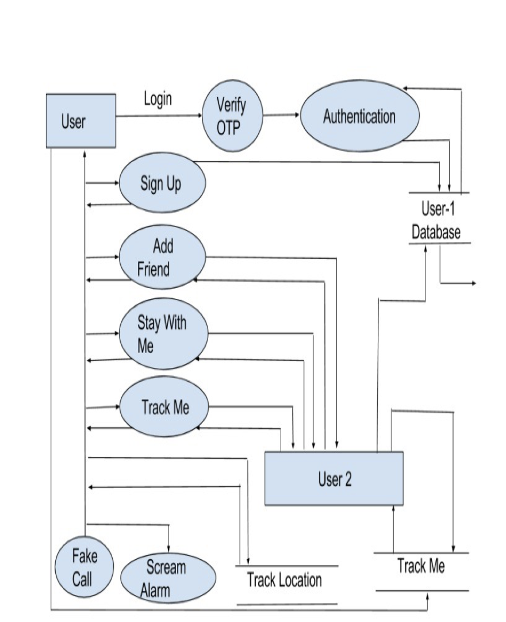
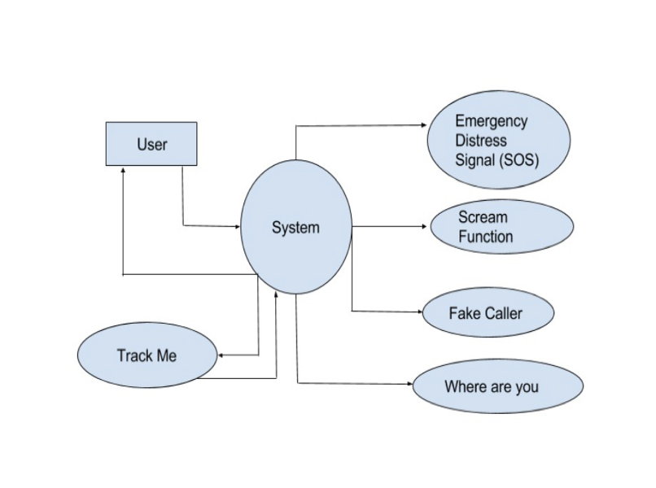
Data Flow Diagrams
Data Flow Diagram Level 2
Data Flow Diagram Level 1

Slide 13
Conclusion
The Idea was to Develop and Design such “Women’s Security App” that meets with the problems of Network Failures. At the time of Distress what's basic comes to mind has to implemented with the Idea to make it more Efficient.

